Slide 1
CUSTOMER RETENSTION CASE STUDY PROJECT

Slide 2
Problem statement:
Customer satisfaction has emerged as one of the most important factors that guarantee the success of online store; it has been posited as a key stimulant of purchase, repurchase intentions and customer loyalty. A comprehensive review of the literature, theories and models have been carried out to propose the models for customer activation and customer retention. Five major factors that contributed to the success of an e-commerce store have been identified as: service quality, system quality, information quality, trust and net benefit. The research furthermore investigated the factors that influence the online customers repeat purchase intention. The combination of both utilitarian value and hedonistic values are needed to affect the repeat purchase intention (loyalty) positively. The data is collected from the Indian online shoppers. Results indicate the e-retail success factors, which are very much critical for customer satisfaction.

Slide 3
EDA Concluding Remarks:
Find patterns of data through visualization and reveal the hidden trends from data.
Using both matplotlib and seaborn library to visualize the data
Finding relationships between features using bar graphs, histograms, box plots, heatmap
Analyzing both the numerical and the categorical columns .

Slide 4
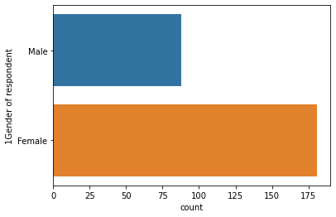
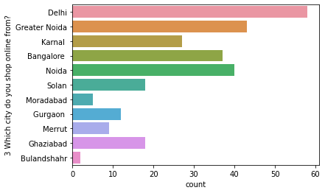
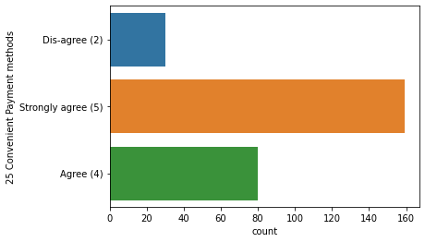
Data visualization

Slide 5
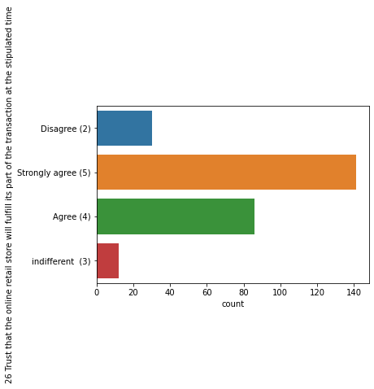
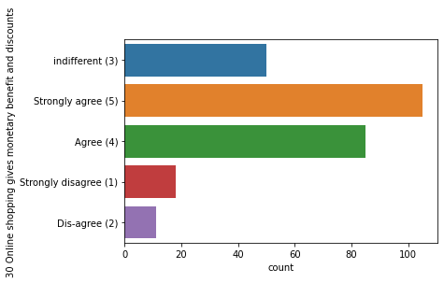
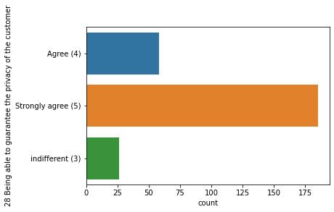

Slide 6
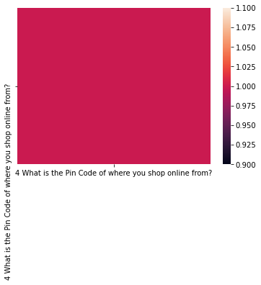
Checking correlation
It is highy correlated

Slide 7
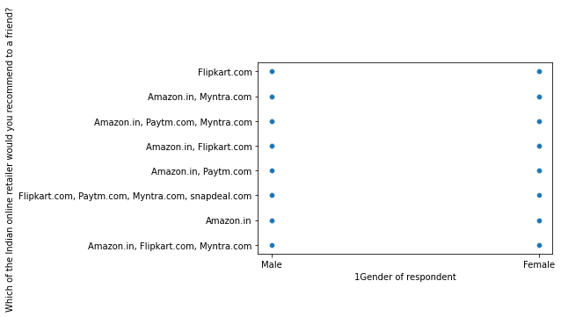
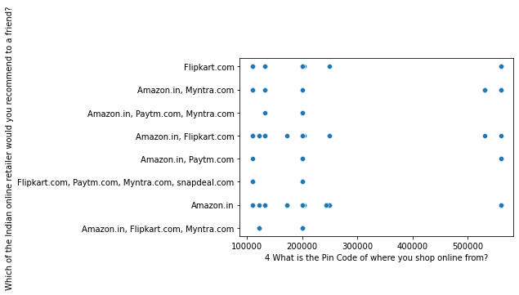
Scatter plot

Slide 8
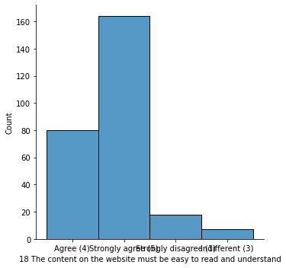
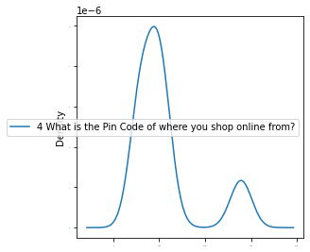
Distribution graph

Slide 9
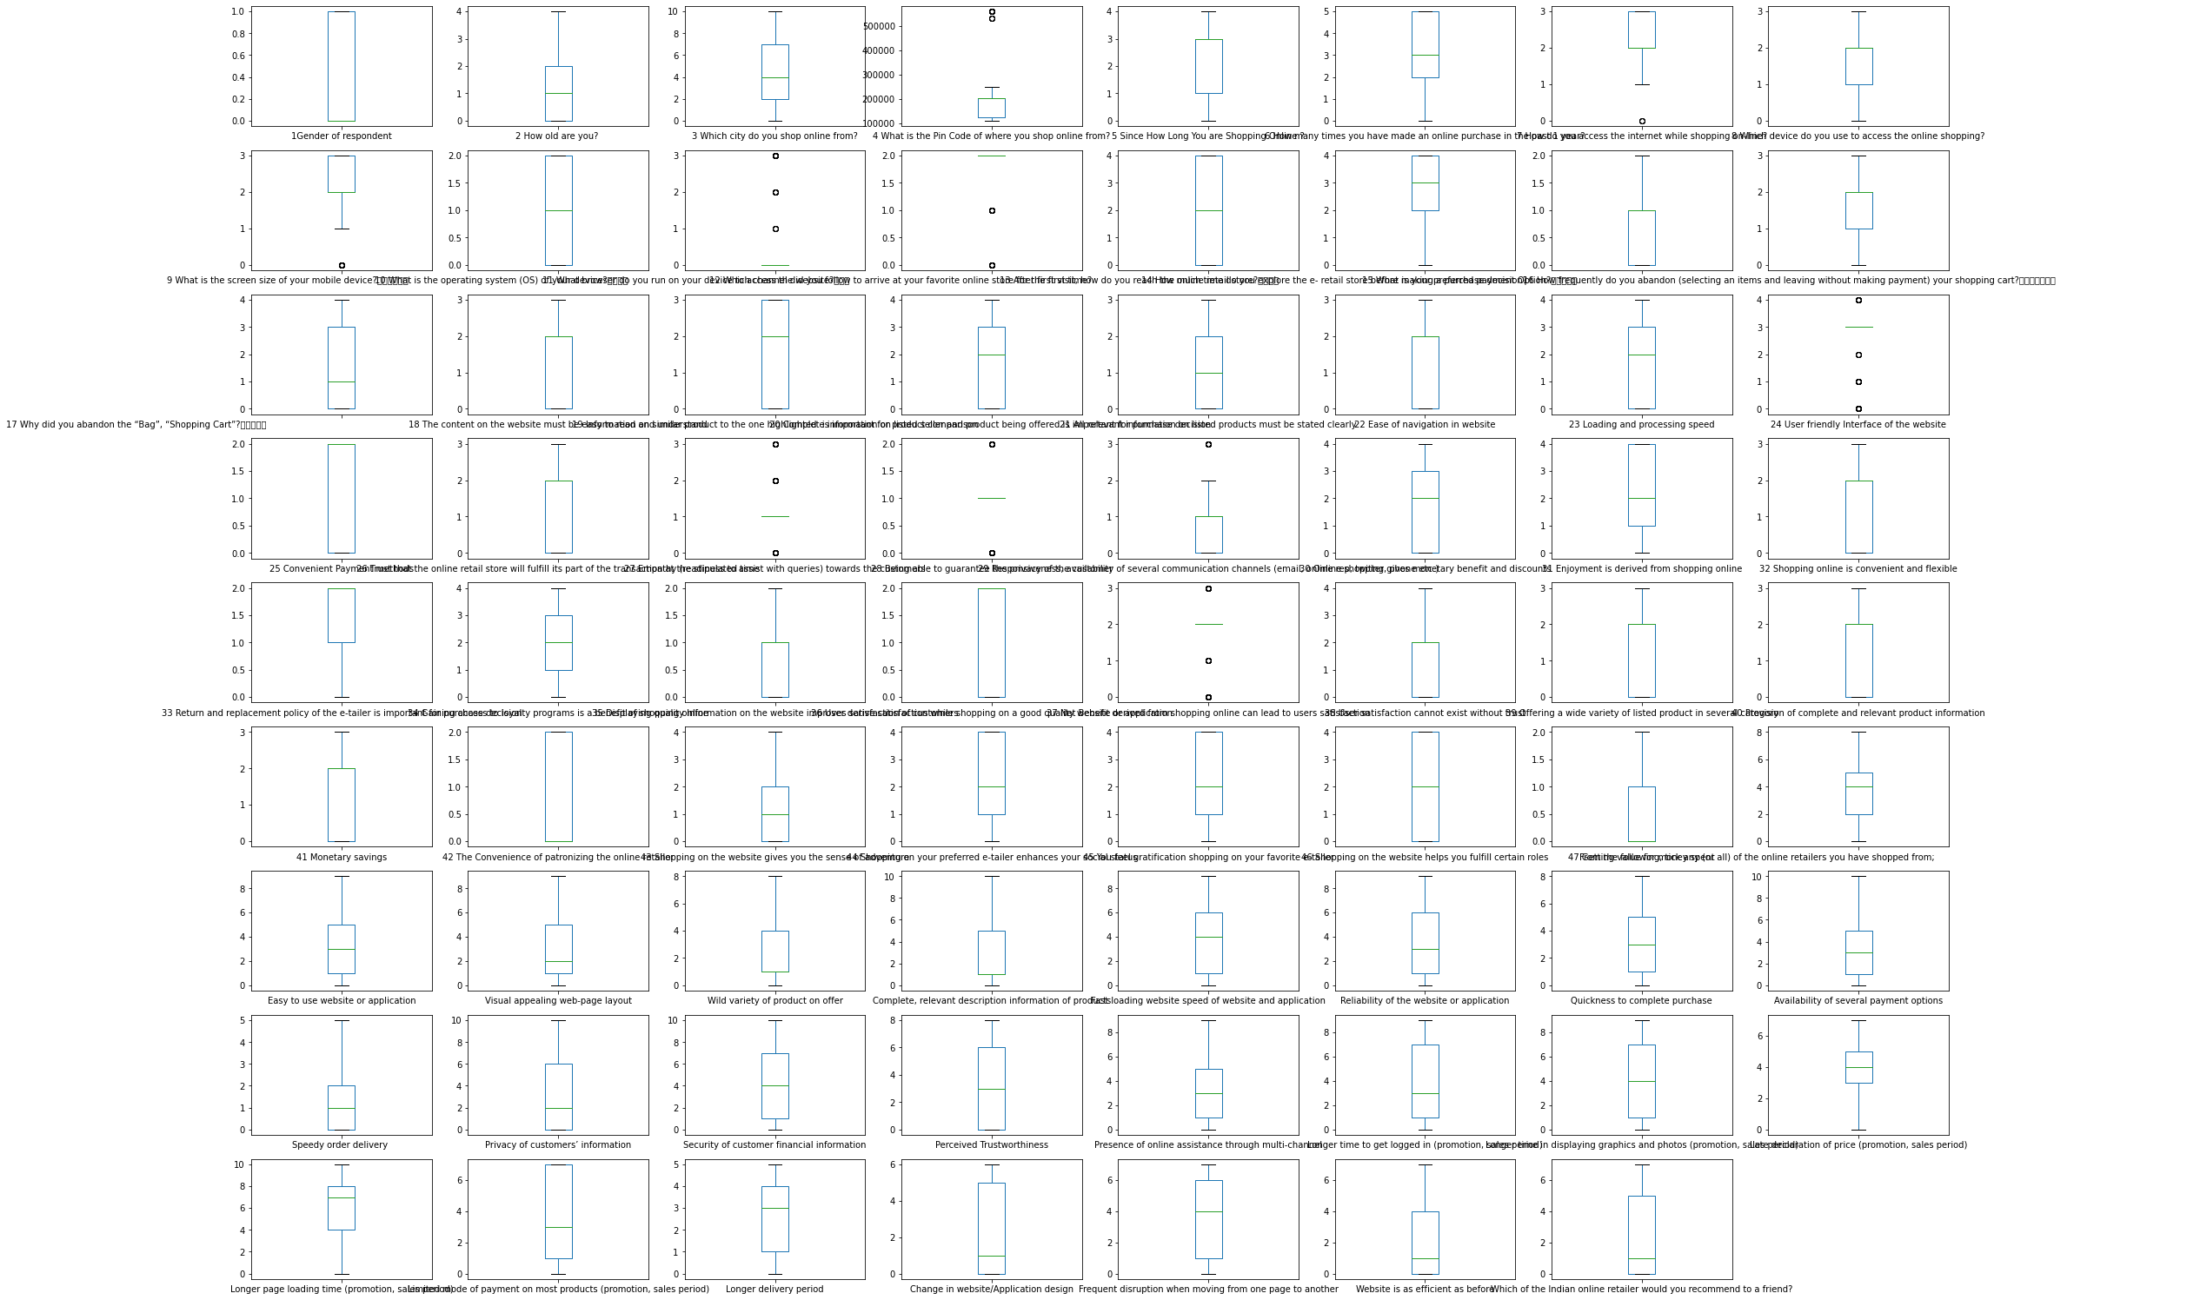
Checking outlier

Slide 10
Pre-processing pipeline
We have to convert every categorical data into numerical data to get our model efficiently.we will do ordinal encoding .after that we will be checking skewness ,as our some data is skewed so we have to do scaling and we will be using standard scalar method.we have draw outlier but we have seen there are very outlier that we can neglect so we can further proceed . Then we have use vif features to check if columns are multicollinear.

Slide 11
conclusion
Customer retention case study is gaining traction in organizations that embrace digital transformation. The scope has
expanded from analytics of employee work performance to providing insights so that decisive improvements can be
made to organizational processes. While some level of attrition is inevitable, it should be kept at the minimal possible
level. This model will allow the company to calculate the probability of an employee to leave the company and to act
On key-factors to avoid departures. The satisfaction of employees and the amount of workload they have to bear seem
To be important causes of withdrawals. A particular attention on the work-life balance would be crucial to improve the
turnover rate

